Slide 1


1
Data Cleaning Using Power Query in Excel
Presented by: Data Team

Slide 2

What is Power Query
With Power Query (called Get & Transform Data in previous Excel versions), you can import or connect to external data, and then shape that data, for example remove a column, change a data type, or merge tables, in ways that meet your needs. Then, you can load your query into Excel to create charts and reports. Periodically, you can refresh the data to make it up-to-date.

Slide 3

Power Query Phases
There are four phases to using Power Query

Slide 4
Connect: Make connections to data in the cloud, on a service, or locally
Transform: Shape data to meet your needs, while the original source remains unchanged
Combine: Integrate data from multiple sources to get a unique view into the data
Load: Complete your query and load it into a worksheet or Data Model and periodically refresh it.

Slide 5
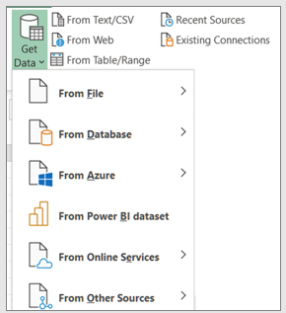
Connect
You can use Power Query to import to a single data source, such as an Excel workbook, or to multiple databases, or services scattered across the cloud. Data sources include data from the Web, files, databases, or Azure. With Power Query, you can then bring all those data sources together using your own unique transformations and combinations to uncover insights you otherwise wouldn’t have seen.
Once imported, you can refresh the data to bring in additions, changes, and deletes from the external data source.

Slide 6
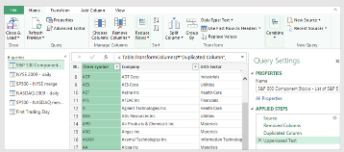
Transform
Transforming data means modifying it in some way to meet your data analysis requirements. For example, you can remove a column, change a data type, or filter rows. Each of these operations is a data transformation.
This process of applying transformations (and combining) to one or more sets of data is also called shaping data.
Power Query uses a dedicated window called the Power Query Editor to facilitate and display data transformations.

Slide 7
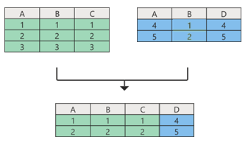
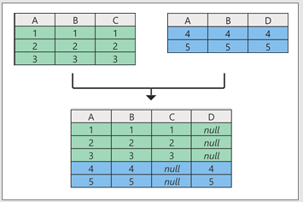
Combine
You can combine multiple queries in your Excel workbook by appending or merging them. The Append and Merge operations are performed on any query with a tabular shape and are independent of the data sources that the data comes from.
Append:
An append operation creates a new query that contains all rows from a first query followed by all rows from a second query.
Merge:
A merge operation creates a new query from two existing queries. This one query contains all columns from a primary table, with one column serving as a navigation link to a related table. The related table contains all rows that match each row from a common column value in the primary table.

Slide 8
Load
There are two main ways to load queries into your workbook:
From the Power Query Editor, you can use the Close and Load commands in the Close group on the Home tab.
From the Excel Workbook Queries pane (Select Queries & Connections), you can right-click a query and select Load To.

Slide 9

Lab session

Slide 10


Thank You

